Slide 1
Master of Science in Computer Science and Engineering
A Trusted and Privacy-Enhanced In-Memory Data Store
Miguel de Lemos Dias Rosa Anciães
Adviser:
Henrique Domingos
27 February 2020

Slide 2
Outline
Dissertation Plan
Context and Motivation
Problem
Objectives and Contributions
Related Work
System Model and Architecture
Approach to Elaboration Phase
Architecture Components and Implementation Guidelines
Testing Environments
Evaluation Criteria
Work Plan
Conclusion
References

Slide 3
Outline
Dissertation Plan
Context and Motivation
Problem
Objectives and Contributions
Related Work
System Model and Architecture
Approach to Elaboration Phase
Architecture Components and Implementation Guidelines
Testing Environments
Evaluation Criteria
Work Plan
Conclusion
References

Slide 4
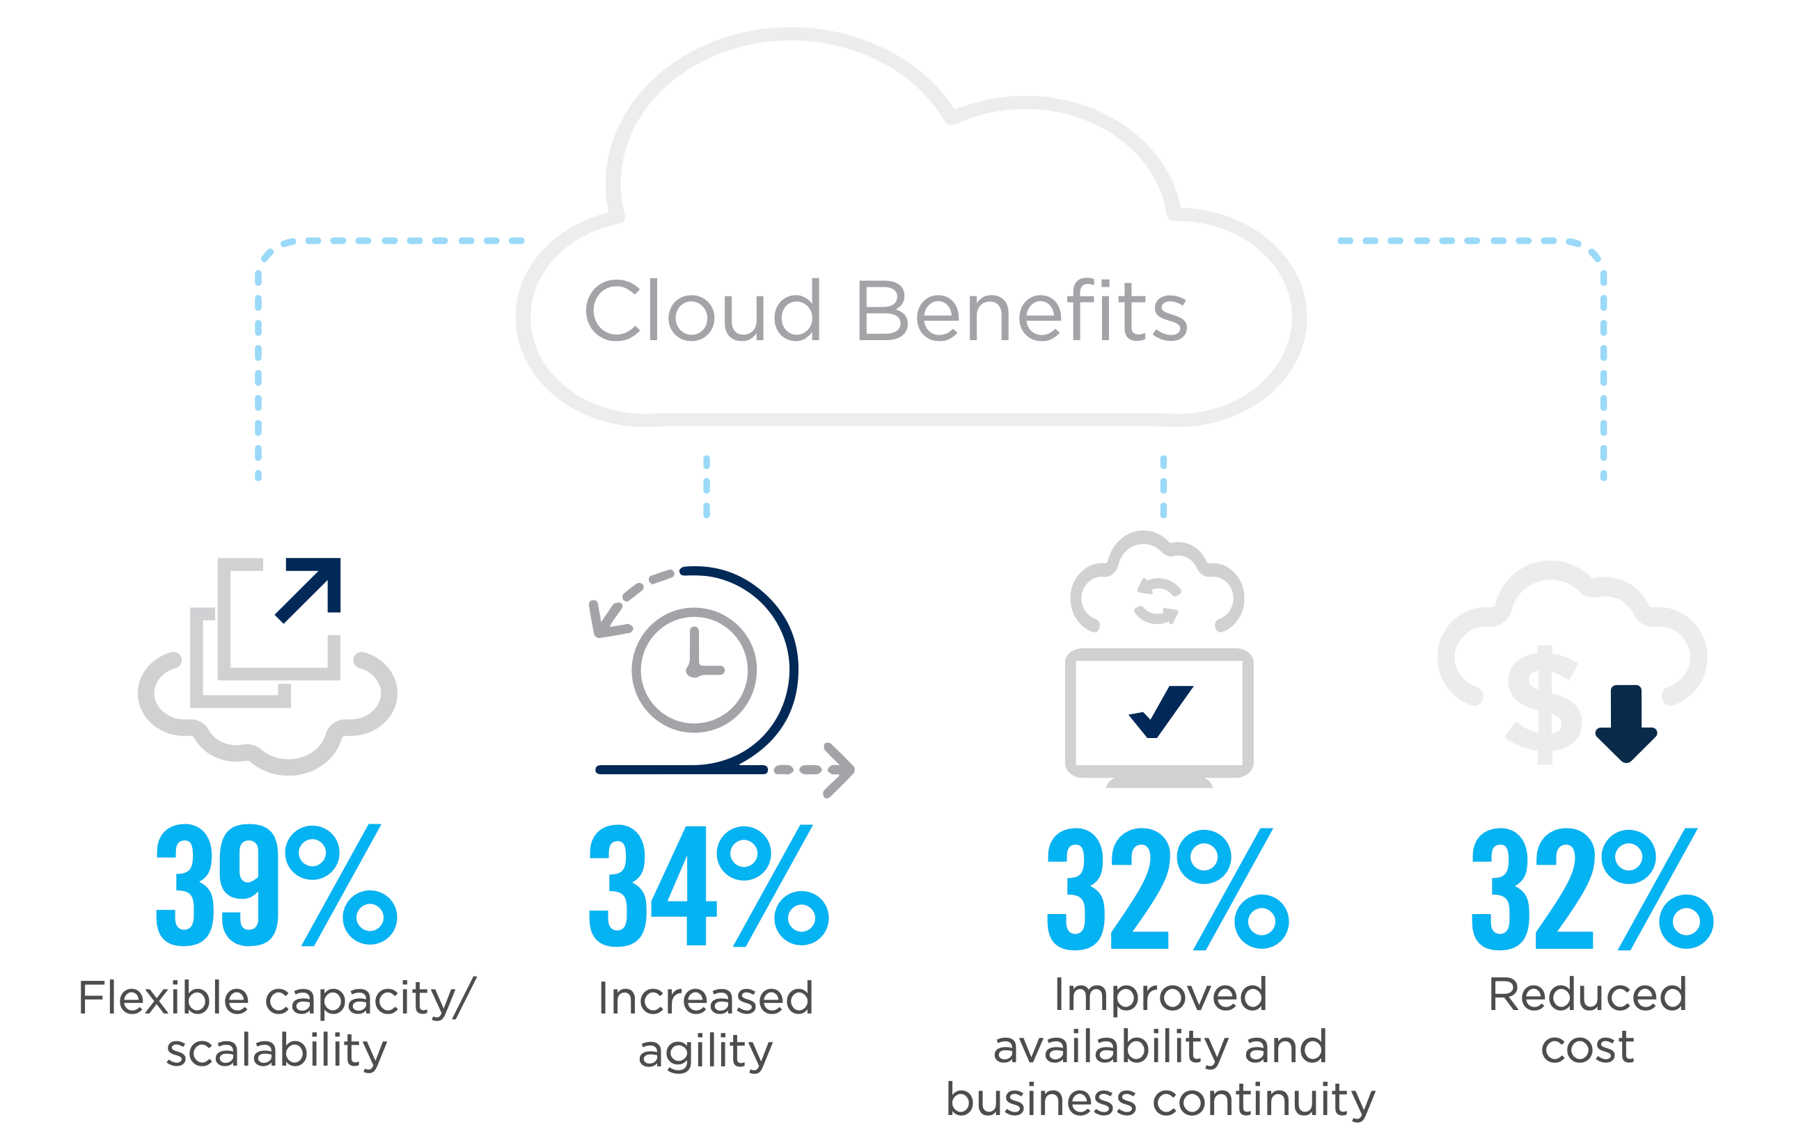
Cloud Benefits
Context and Motivation
Source: isc2.org

Slide 5
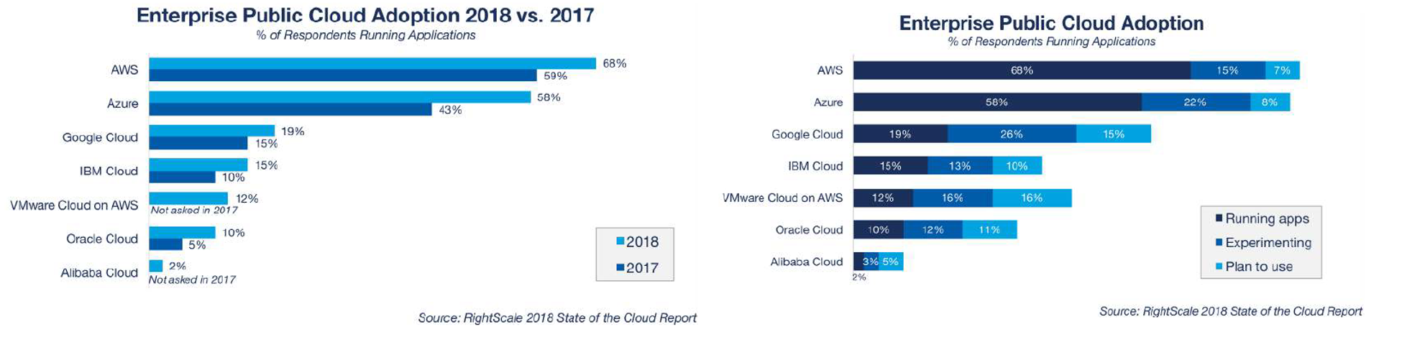
Cloud Adoption
Context and Motivation

Slide 6
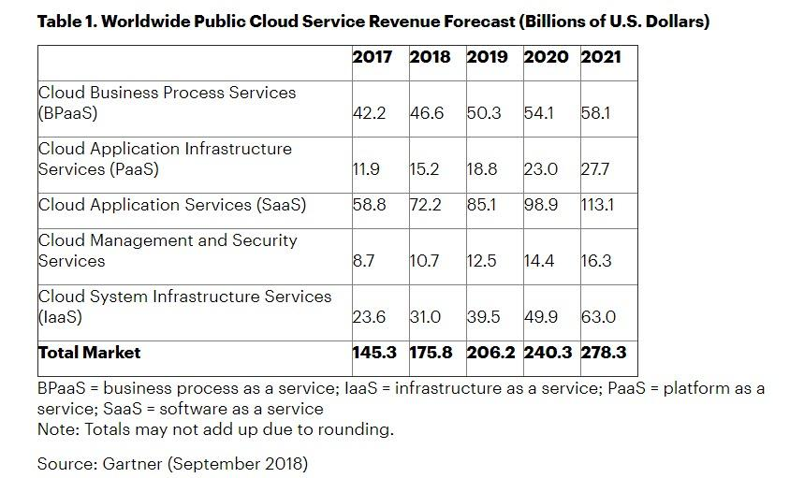
Cloud Revenue
Context and Motivation

Slide 7
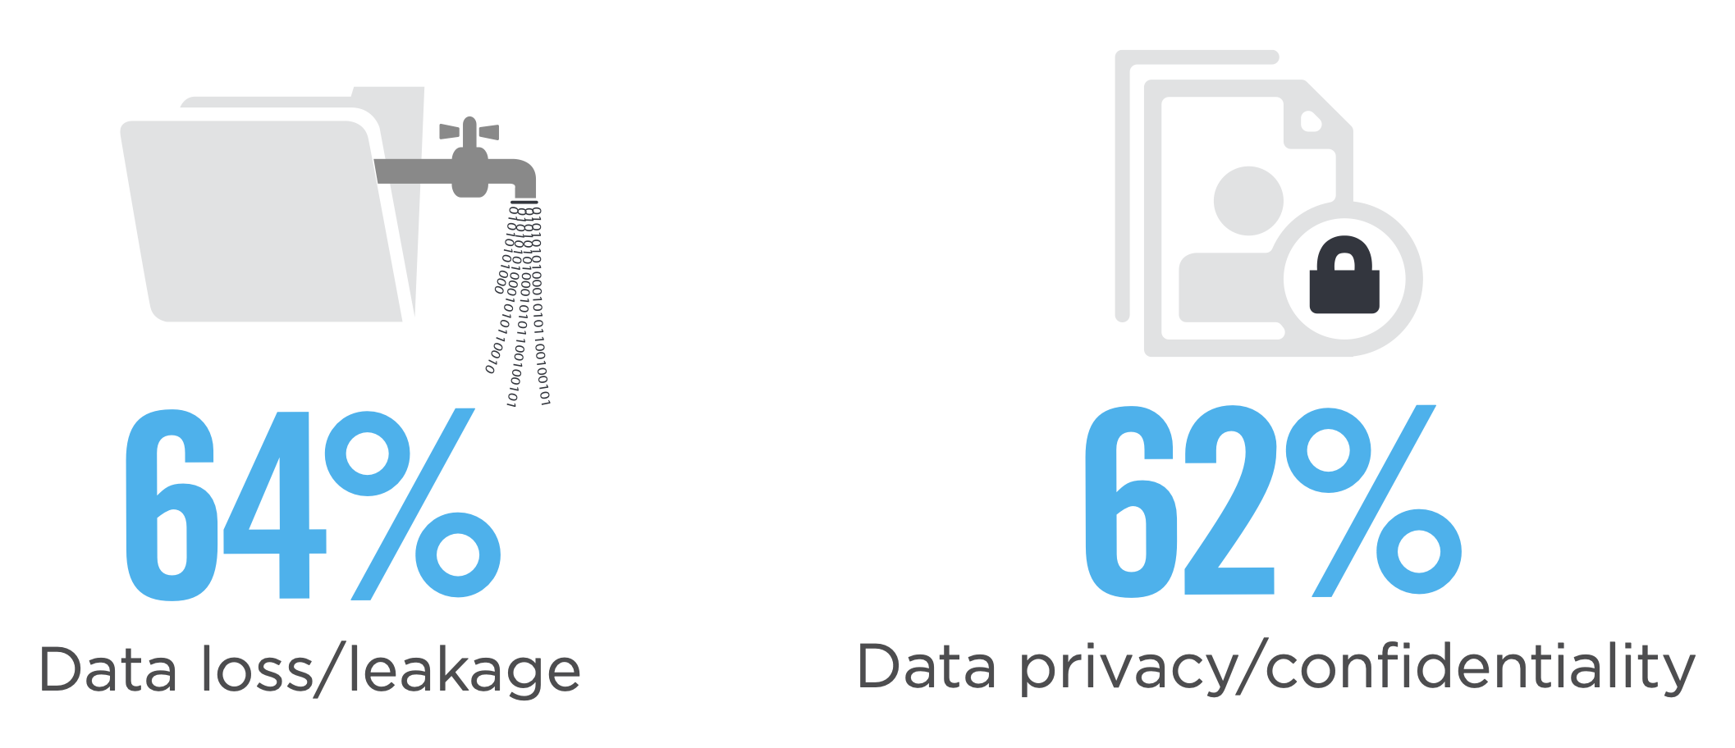
Cloud Security Concerns
Context and Motivation
Source: isc2.org
Notes:
TODO: https://www.cybersecurity-insiders.com/by-2023-cloud-security-spending-to-reach-12-6-billion/

Slide 8
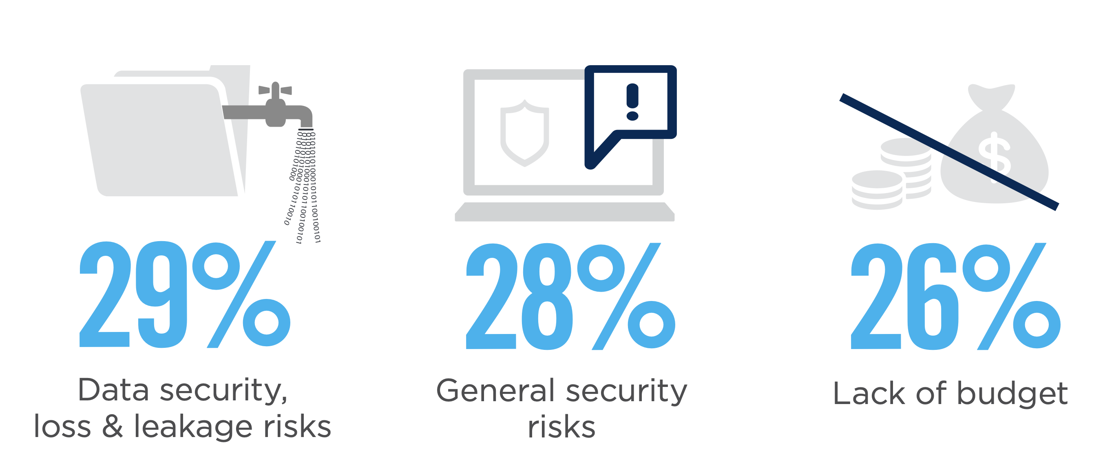
Cloud Adoption Barriers
Context and Motivation
Source: isc2.org

Slide 9
Recent Events
Context and Motivation
”Attacks on the Cloud Increase by 300%” - Microsoft
Notes:
TODO: Add news reports of data leakeges on cloud and attcks on cloud provider.

Slide 10
Outline
Dissertation Plan
Context and Motivation
Problem
Objectives and Contributions
Related Work
System Model and Architecture
Approach to Elaboration Phase
Architecture Components and Implementation Guidelines
Testing Environments
Evaluation Criteria
Work Plan
Conclusion
References

Slide 11


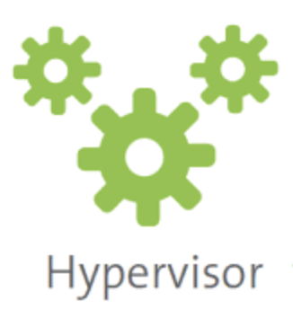
Problem
Problem
Insider threats - Honest but Curious model, negligent employee, exploited employee, malicious insiders
Large Trusted Computing Base – Too many components out of the control of the user have to be deeamed trusted
Performance over secure large datasets
Notes:
Insider Threats - Is it feasible to implement a solution for a remote trusted and privacy-enhanced cloud-based key value store system providing strong security and privacy features in a trustworthy solution?
Large TCB - Can we address the trust-ability by minimising the trust-computing base using protected components running as isolated trusted bases in hardware-shielded trust execution environments?
Performance - Can we combine the security guarantees with privacy-enhanced in-memory operations supporting big data sets and grained data-structures?

Slide 12
Outline
Dissertation Plan
Context and Motivation
Problem
Objectives and Contributions
Related Work
System Model and Architecture
Approach to Elaboration Phase
Architecture Components and Implementation Guidelines
Testing Environments
Evaluation Criteria
Work Plan
Conclusion
References

Slide 13
Objectives and Contributions
Dissertation Goal
Design and implementation of the cloud-enabled privacy-enhanced solution
Trust-ability, security and privacy
TCB Reduction
Complete Analysis Report
Software attestation
Multiple Replication Mechanisms
Centralised Solution
Master-Slave architecture
Clustering Solution
Isolation
Standard Solution vs. Privacy Enhanced Solution

Slide 14
Outline
Dissertation Plan
Context and Motivation
Problem
Objectives and Contributions
Related Work
System Model and Architecture
Approach to Elaboration Phase
Architecture Components and Implementation Guidelines
Testing Environments
Evaluation Criteria
Work Plan
Conclusion
References

Slide 15


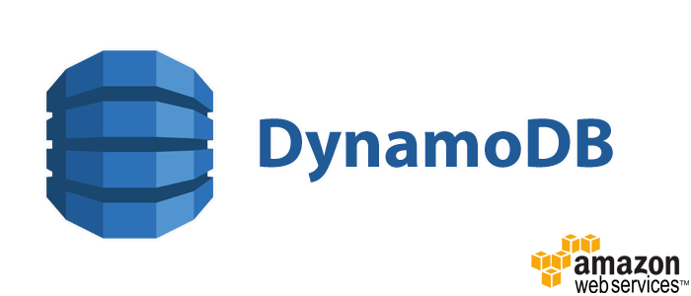


Key Value Stores
Related Work
Primary Concerns
Performance
Simplicity
Secondary Concerns
Security
Availability
Persistence
Replication
Consistency

Slide 16

Trusted Execution Environments
Related Work
Loaded code is authentic not tampered by an attacker.
All system state is correct (CPU registers, memory and sensitive I/O).
The code, all data generated and runtime state is confidential.

Slide 17
Intel SGX
Related Work
Trusted
Untrusted
Application is broken into two parts
Trusted code is isolated by runing and and storing data in Enclaves.
Enclaves are memory regions with strong access control.
Enclave size is limited.
Isolation

Slide 18
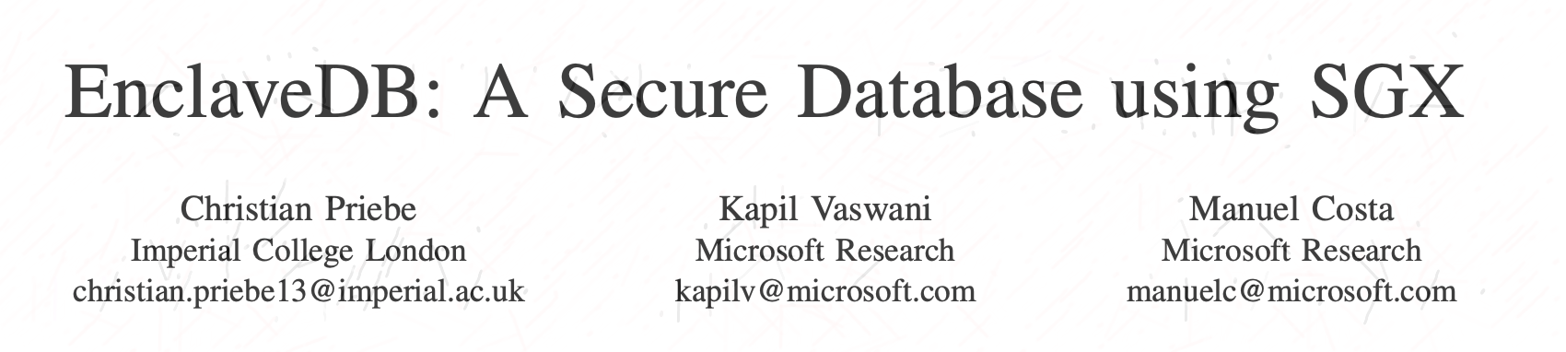
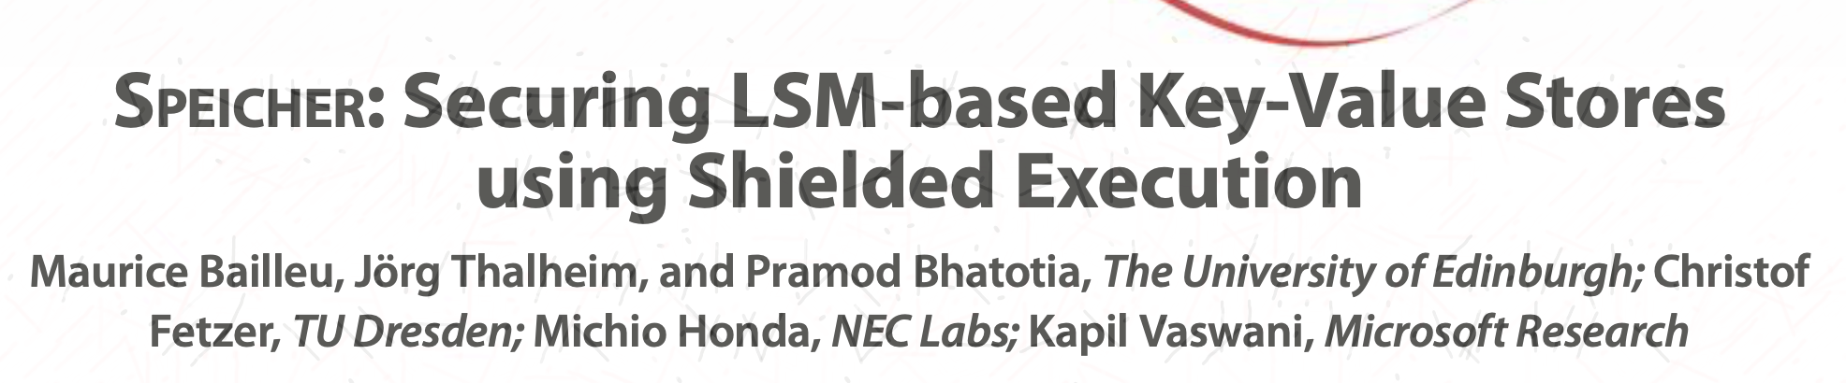
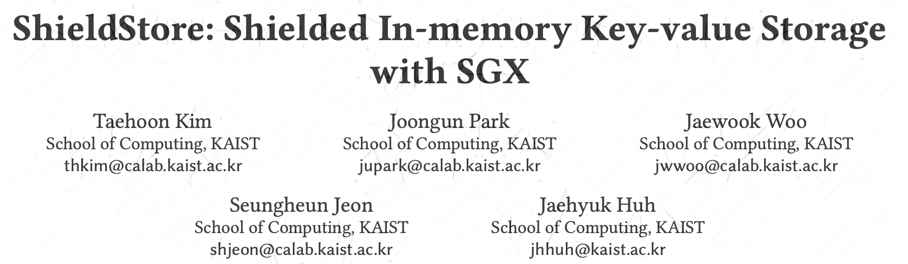
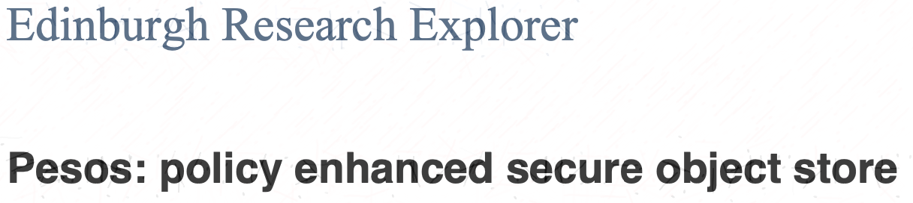
SGX Enabled KVSs
Related Work
Enclave Size Limited
Storage Outside Enclave
Notes:
Enclave DB – Simple kvs inside enclave. Relies on page sawpping an admits large memory
Pesos – Object Store inside enclave
Speicher – Optimized for persistence storage
ShieldSTore – Optimised for performance

Slide 19
Outline
Dissertation Plan
Context and Motivation
Problem
Objectives and Contributions
Related Work
System Model and Architecture
Approach to Elaboration Phase
Architecture Components and Implementation Guidelines
Testing Environments
Evaluation Criteria
Work Plan
Conclusion
References

Slide 20
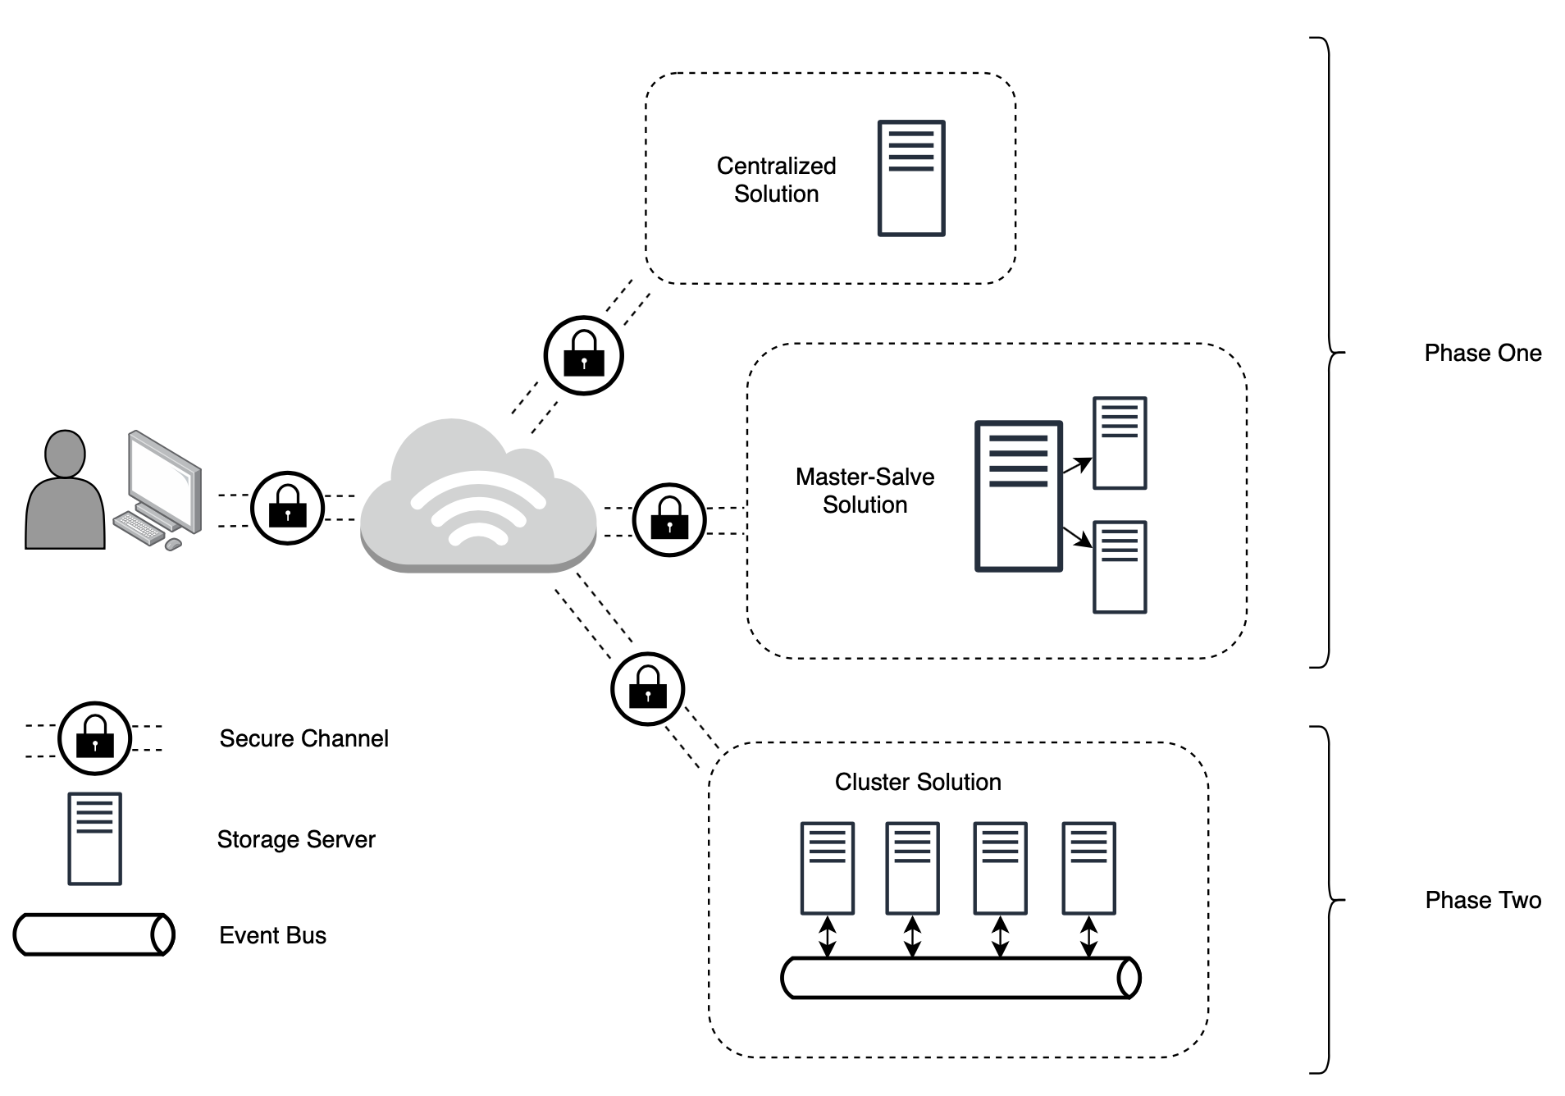
System Model
System Model

Slide 21

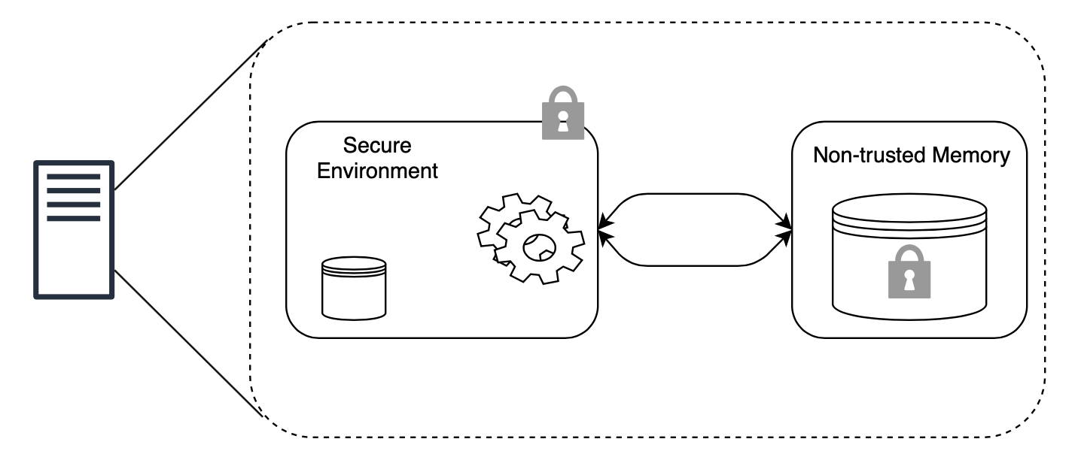
SGX Limitations and Solutions
System Model
Memory
Performance

Slide 22

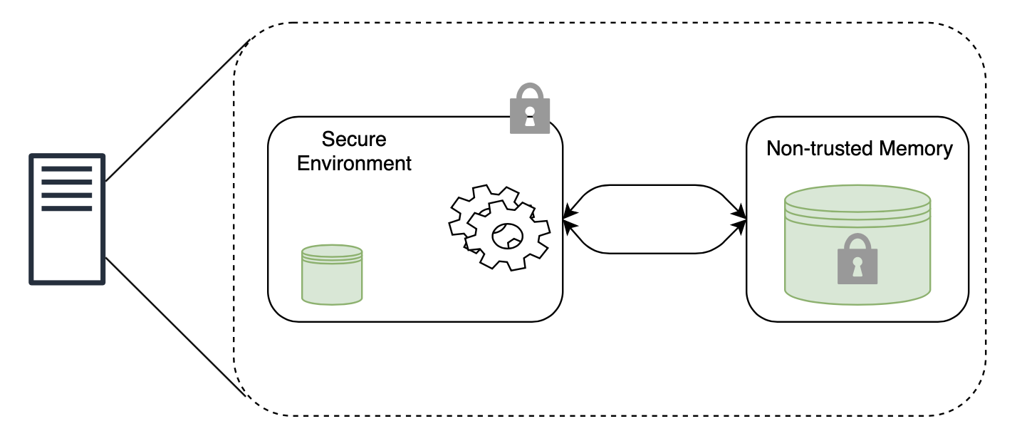
SGX Limitations and Solutions
System Model
Memory
Performance
Hybrid Memory Approach

Slide 23
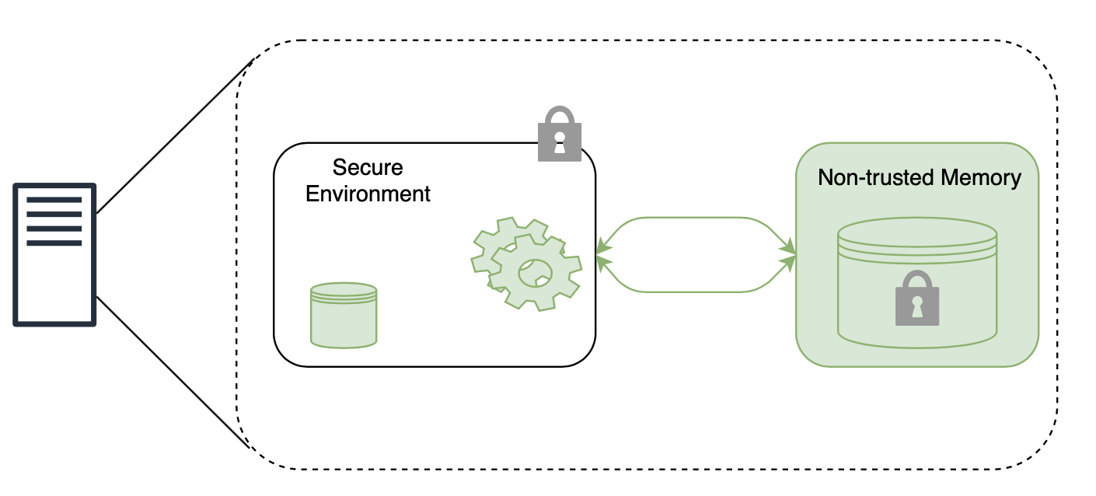
SGX Limitations and Solutions
System Model
Memory
Performance
Hybrid Memory Approach
Homomorphic Encryption

Slide 24
Outline
Dissertation Plan
Context and Motivation
Problem
Objectives and Contributions
Related Work
System Model and Architecture
Approach to Elaboration Phase
Architecture Components and Implementation Guidelines
Testing Environment
Evaluation Criteria
Work Plan
Conclusion
References

Slide 25
Client Side
Architecture Components
Client Security is out of scope.
Manage Homomorphic Encryption Keys.
Represented by benchmark applications:
Redis Benchmark Client
Yahoo! Cloud Serving Benchmark
Notes:
Client Side is considered trusted

Slide 26
Communication
Architecture Components
SGX Termination
Backend Node
SGX
HTTPS over TLS/SSL

Slide 27
Backend Storage Service
Architecture Components
GSC – Graphene SGX Container
Host OS
SGX

Slide 28
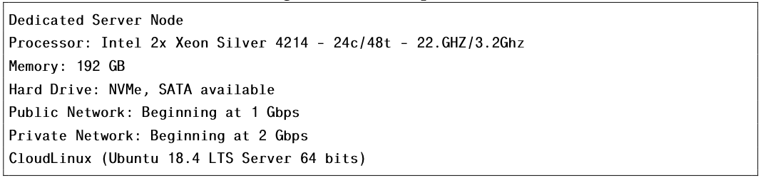
Test Bench Environment
Production Environment
Elaboration Phase

Slide 29
Evaluation Criteria
Elaboration Phase
Performance
Latency
Throughput (ops/s)
Resource Monitoring
Memory Consumption
CPU Load
Power Consumption

Slide 30
Outline
Dissertation Plan
Context and Motivation
Problem
Objectives and Contributions
Related Work
System Model and Architecture
Approach to Elaboration Phase
Architecture Components and Implementation Guidelines
Testing Environments
Evaluation Criteria
Work Plan
Conclusion
References

Slide 31
Planned Tasks/Timeframes
Work Plan
System Model and Architecture Refinement (2 Weeks)
Setup Development Environment
(4 Weeks)
Tests of phase 1 Prototype
Deployment into Production Environment (6 Weeks)
Final Tests and benchmarks
Development of Prototype Phase 1 (8 Weeks)
Development of Prototype Phase 2 (6 Weeks)
Tests of phase 2 Prototype
Dissertation Writing
Notes:
Development of phases timeframe is plus testing. Dissertation writing is done continouasly throughout the time and with specific enfase during the end of some tasks

Slide 32
Outline
Dissertation Plan
Context and Motivation
Problem
Objectives and Contributions
Related Work
System Model and Architecture
Approach to Elaboration Phase
Architecture Components and Implementation Guidelines
Testing Environments
Evaluation Criteria
Work Plan
Conclusion
References

Slide 33
Conclusion
Dissertation Plan
Necessity
Problem
Idea/Contribution
Solution

Slide 34
References
Bibliography
Cloud Benefits; Cloud Security Concerns; Cloud Security Barriers –
https://www.isc2.org/-/media/ISC2/Landing-Pages/2019-Cloud-Security-Report-ISC2.ashx?la=en&hash=06133FF277FCCFF720FC8B96DF505CA66A7CE565https://www.isc2.org/-/media/ISC2/Landing-Pages/2019-Cloud-Security-Report-ISC2.ashx?la=en&hash=06133FF277FCCFF720FC8B96DF505CA66A7CE565
Cloud Adoption; Cloud Revenue - https://www.forbes.com/sites/louiscolumbus/2018/09/23/roundup-of-cloud-computing-forecasts-and-market-estimates-2018/
Attacks - https://www.infosecurity-magazine.com/news/attacks-cloud-increase-300/
Intel SGX - https://assets.hardwarezone.com/img/2017/02/application_500H.jpg

